Slide 22
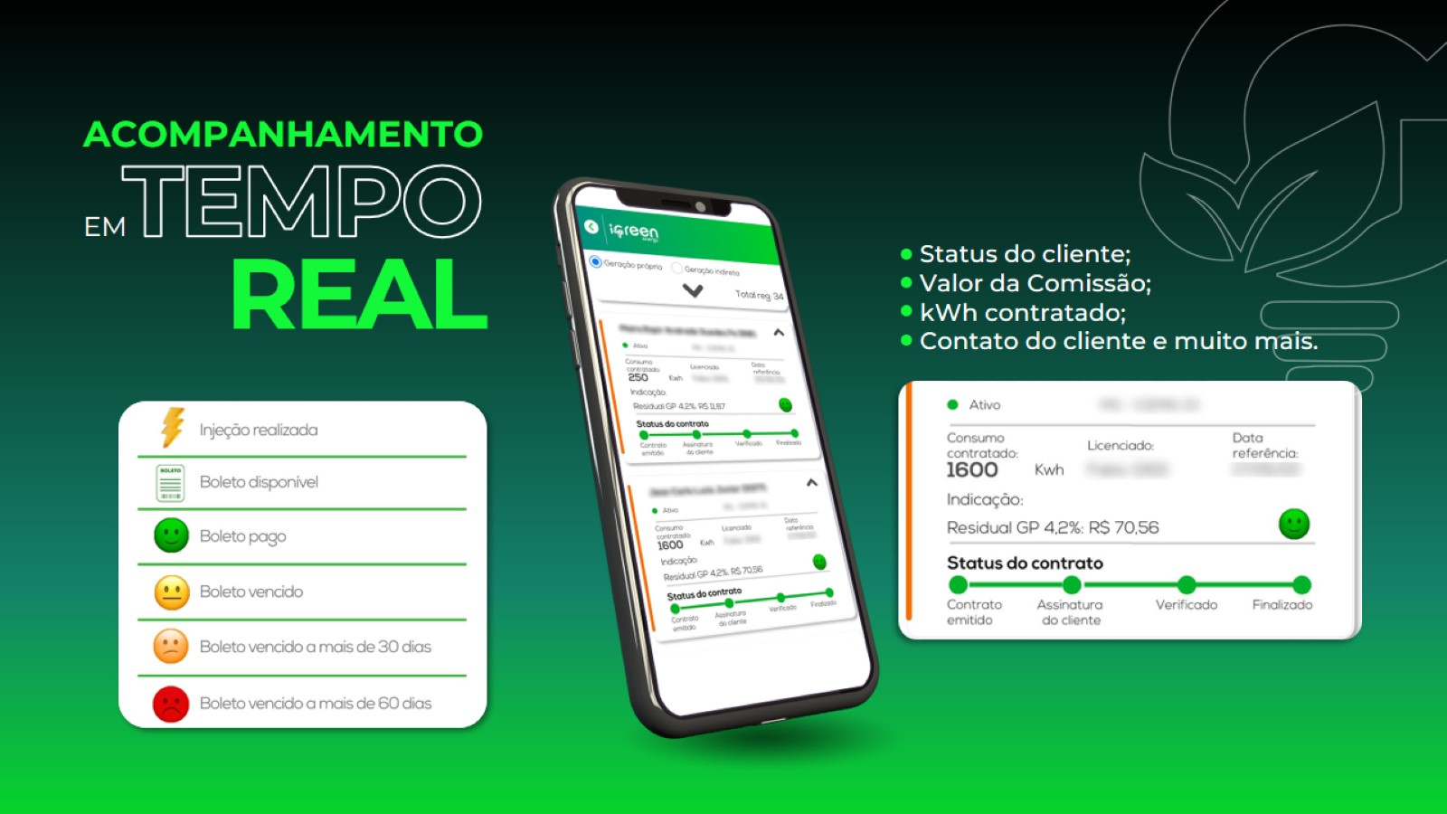

Slide 29
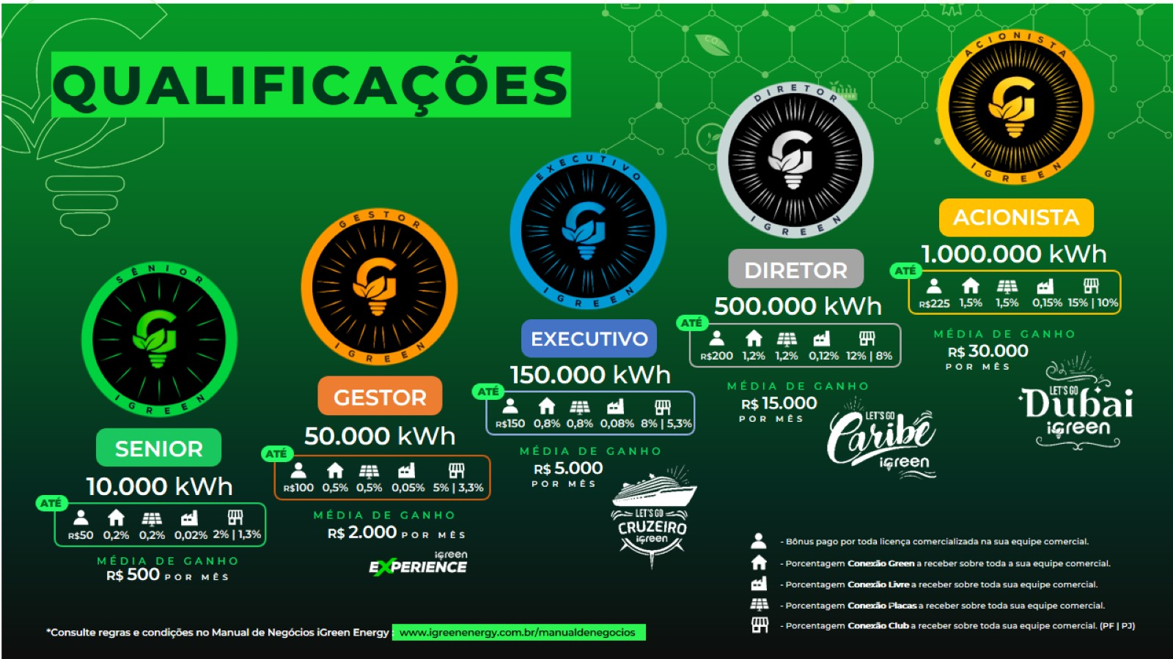

Slide 32
GREEN POINTS

Slide 65
GREEN POINTS

